Slide 1
What organisms do you think of when you hear the word “endangered”? Write down a few of them on your handout.

Slide 2
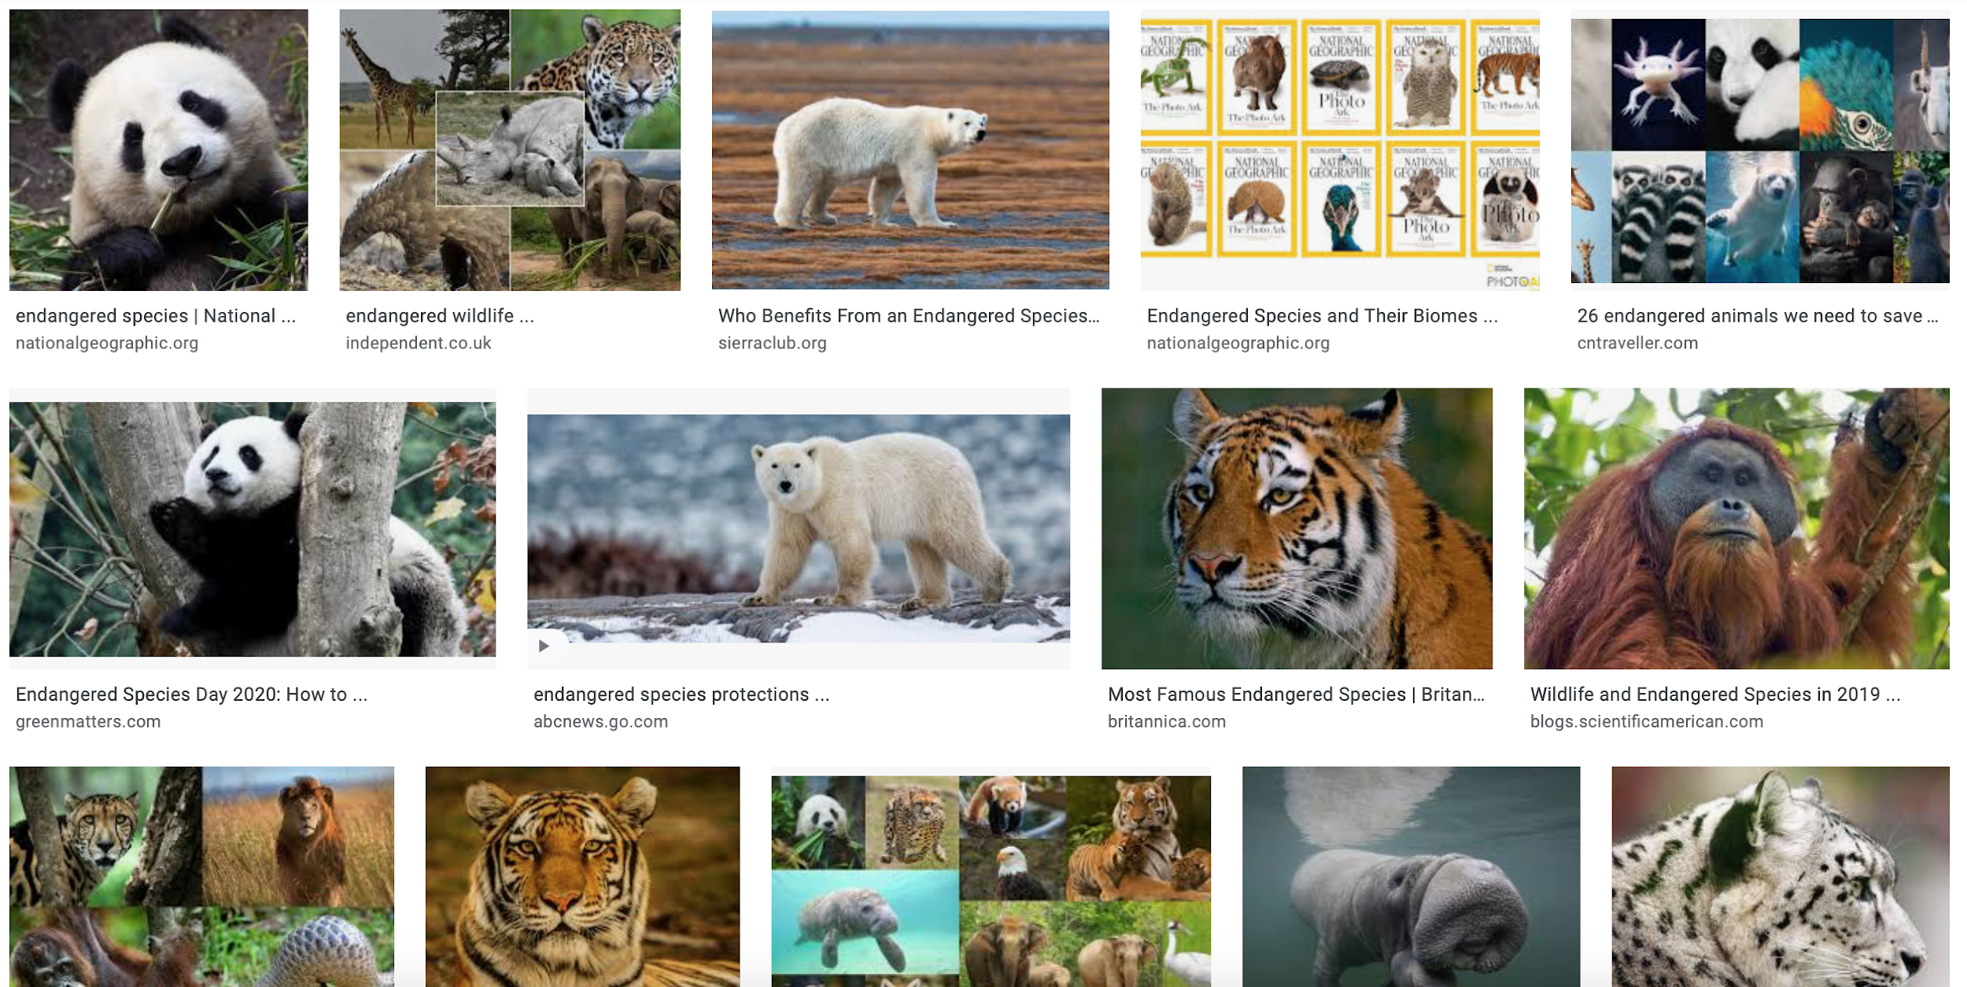
Here is a recent Google Image search for “endangered species” …

Slide 3
Most people think of these animals.
Pandas
Lemurs
Tigers and other big cats
Orangutans and other primates
Whales
What do these organisms all have in common?
All mammals, all large, etc.
Photo credit: Mohd Rasfan, AFP/Getty Images

Slide 4
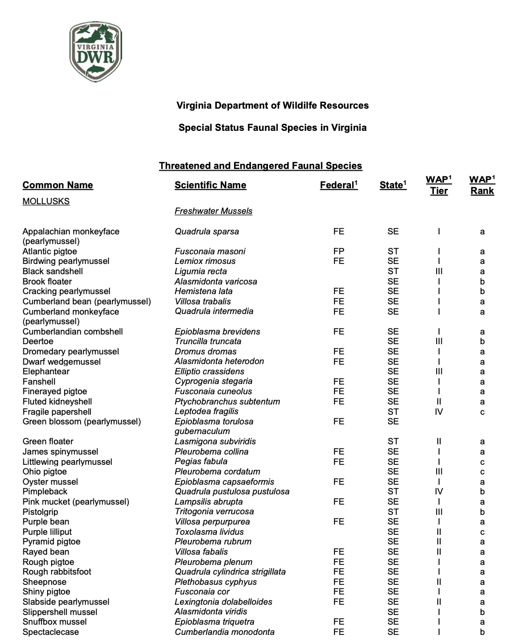
Do we have listed species here in Appalachia?
Lots, unfortunately.
Of the listed species in Virginia on the Virginia Department of Wildlife Resources webpage, these are SOME of the listed FRESHWATER MUSSELS – almost all of which are listed as “Federal Endangered.”

Slide 5
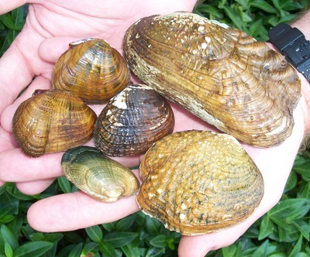
Photo credit: US Fish and Wildlife Service

Slide 6
How about the Eastern hellbender?
Very sensitive to pollution from agriculture and mining (breathes through its skin, lays eggs underwater)
Deforestation leads to heavy sediment loads that can eliminate good nesting habitat by filling in gaps between rocks
Listed as endangered or threatened by many states throughout its range
Denied listing by the federal government under the Endangered Species Act in April 2019
Photo credit: Virginia Tech

Slide 7
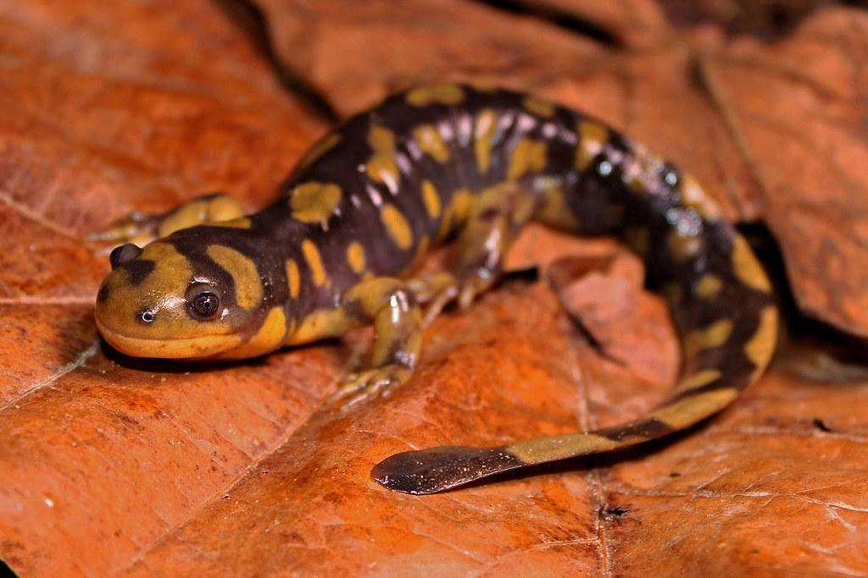
Endangered in Appalachia: Species Profiles
With a partner, use a computer to research an endangered/threatened species in your local area
Complete your ”Endangered in Appalachia: Species Profile” handout and be prepared to share with the class!
Photo credit: Peter Paplanus, Flickr

Slide 8
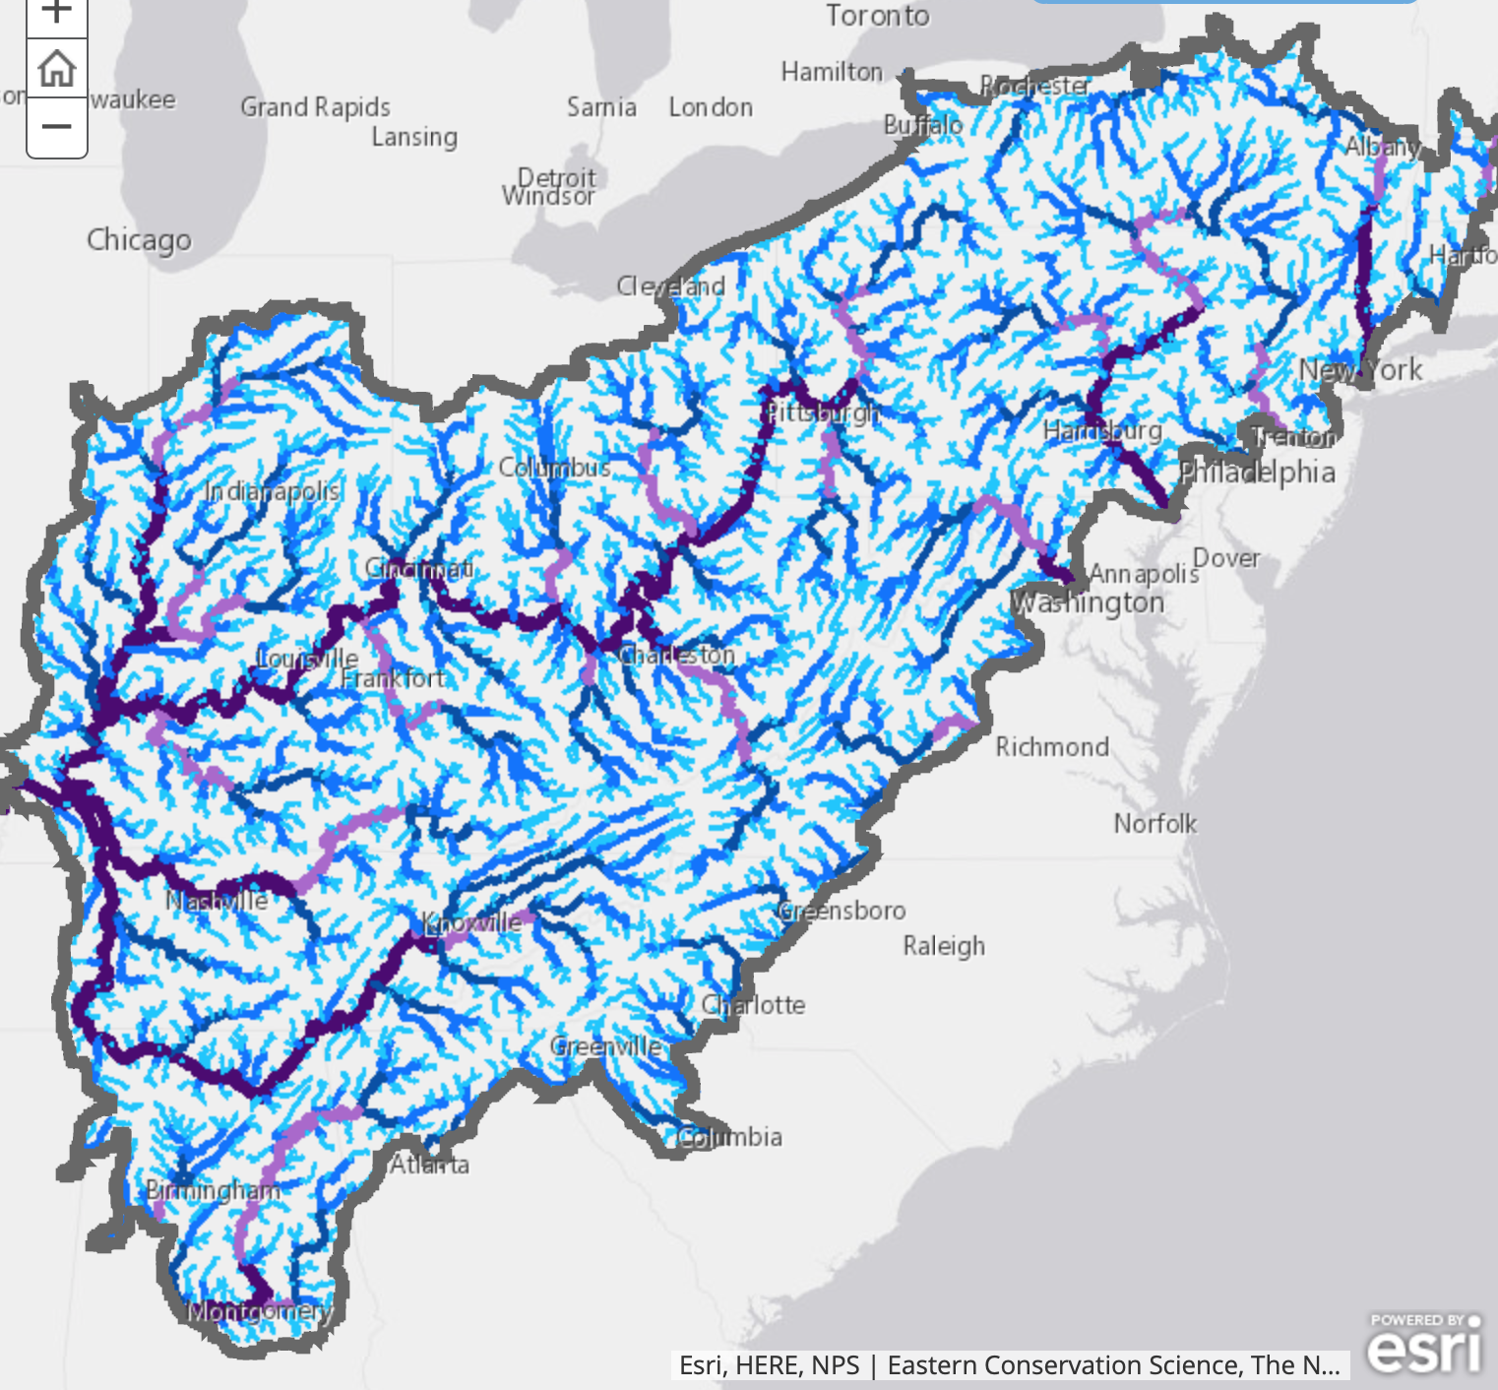
What’s happening in your state?
Here are a few examples.

Slide 9
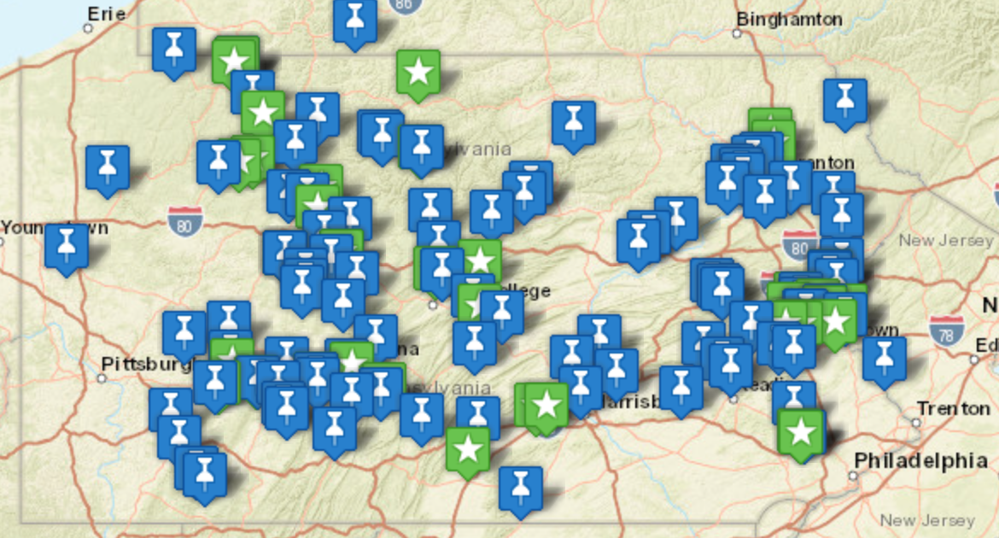
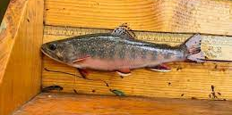
Pennsylvania
The Coldwater Heritage Partnership is one of many organizations offering grants for projects that prioritize freshwater conservation across PA
Efforts include protection and replanting of riparian buffer zones, removal of invasive species, and monitoring native trout populations
Photo credit: Coldwater Heritage Partnership
Photo credit: Coldwater Heritage Partnership, Seneca Chapter of Trout Unlimited

Slide 10
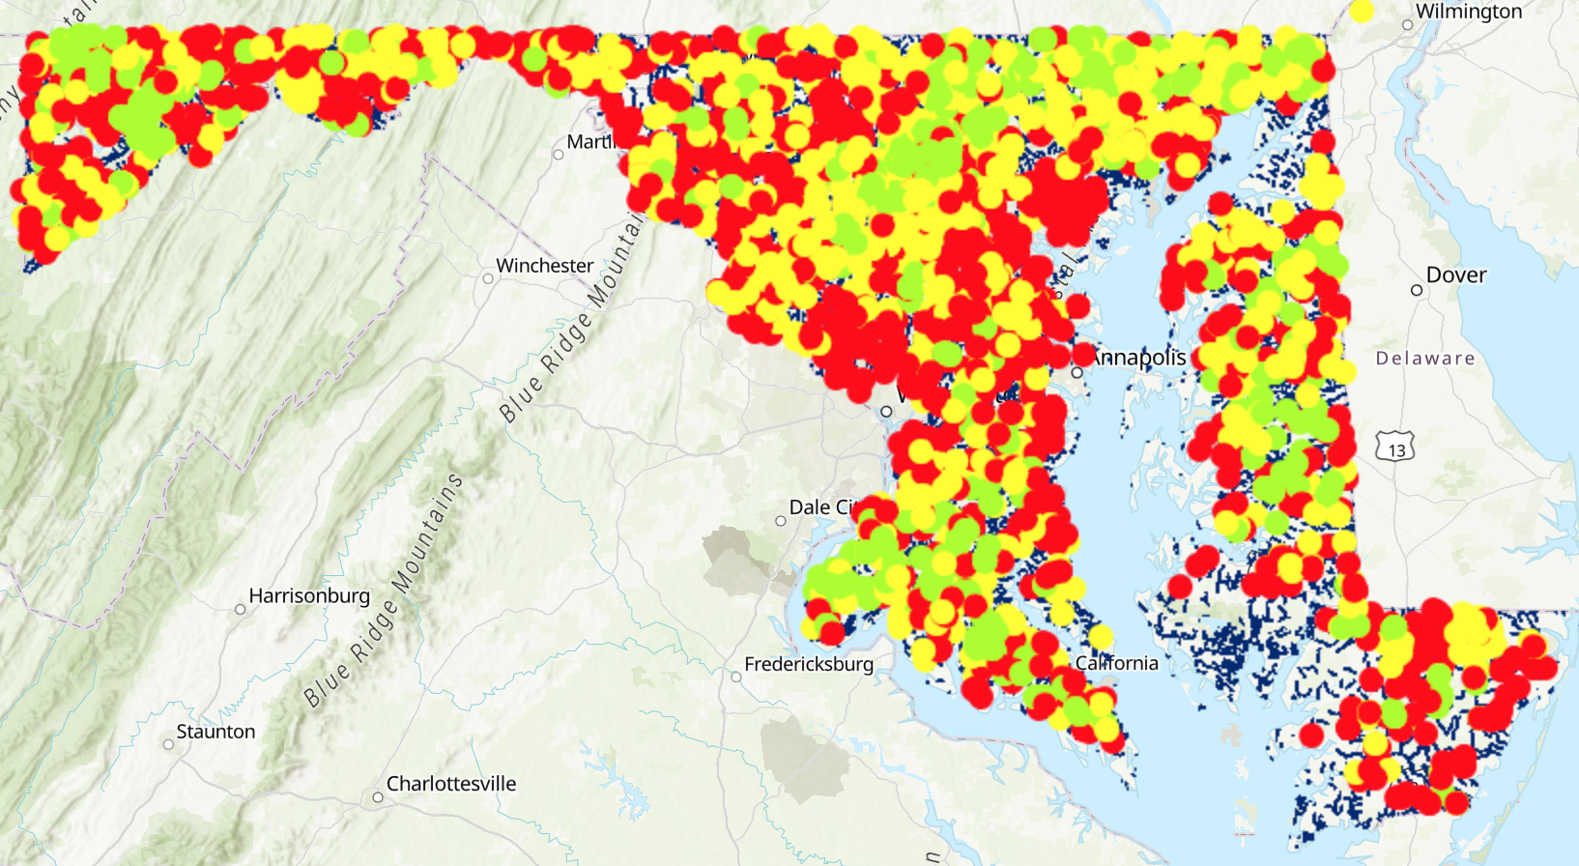
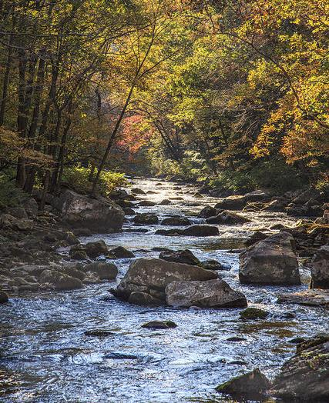
Maryland
Photo credits: Maryland Dept of Natural Resources
Maryland Biological Stream Survey
Assesses diversity and stream health across MD
Identifies impacts of climate change, acidic deposition, and other stressors on populations of stream species
Conducted several times since 1995, interactive map shows status of streams across the state

Slide 11
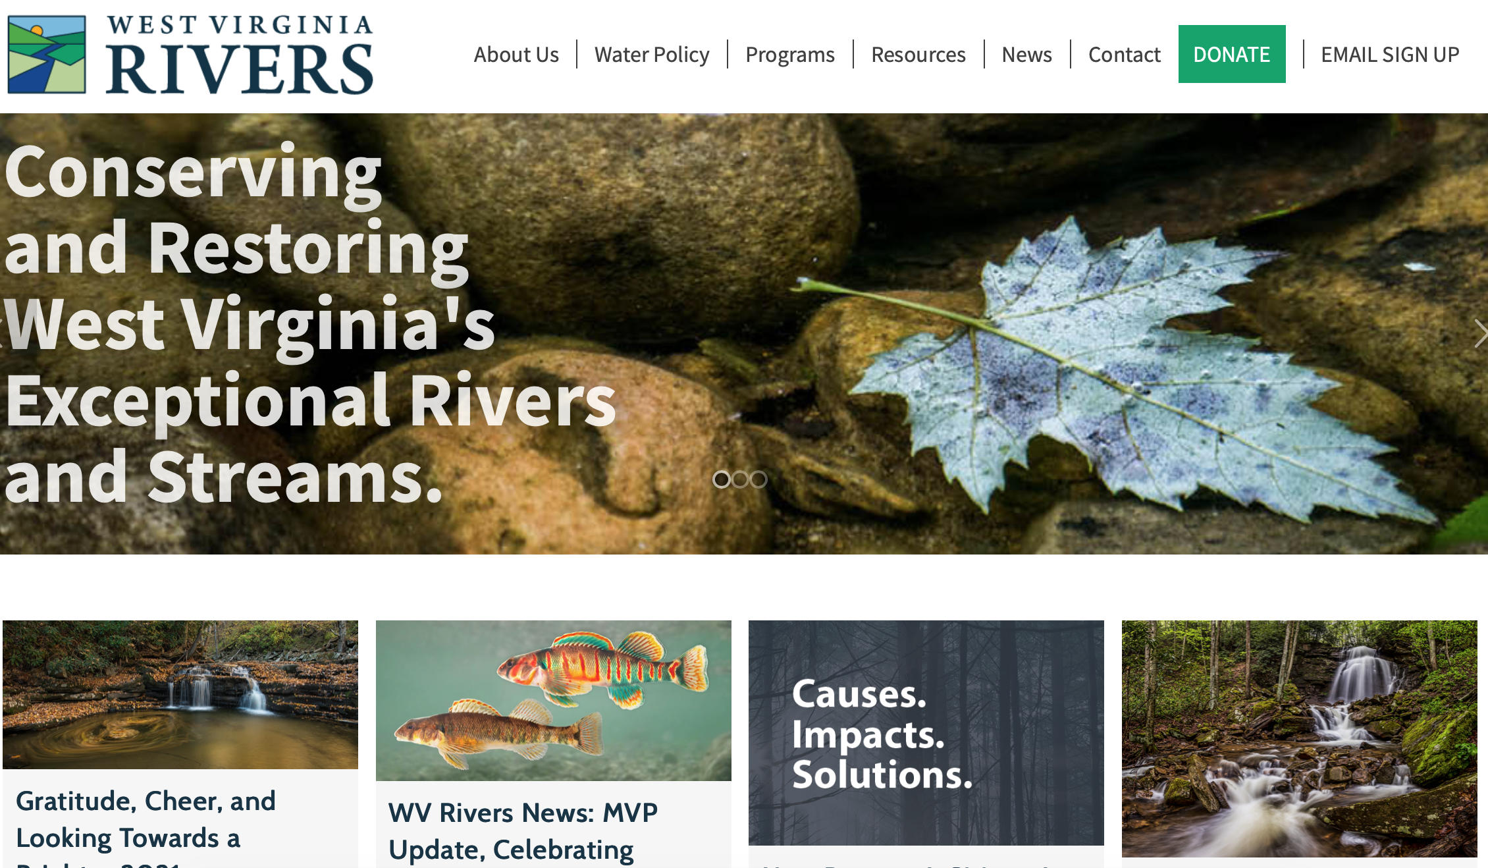
West Virginia
West Virginia Rivers Coalition
Prioritizes state legislation targeting water pollution, site clean-up by bankrupt coal companies, and pipeline development projects
Focus on community involvement and education
Photo credit: West Virginia Rivers Coalition

Slide 12
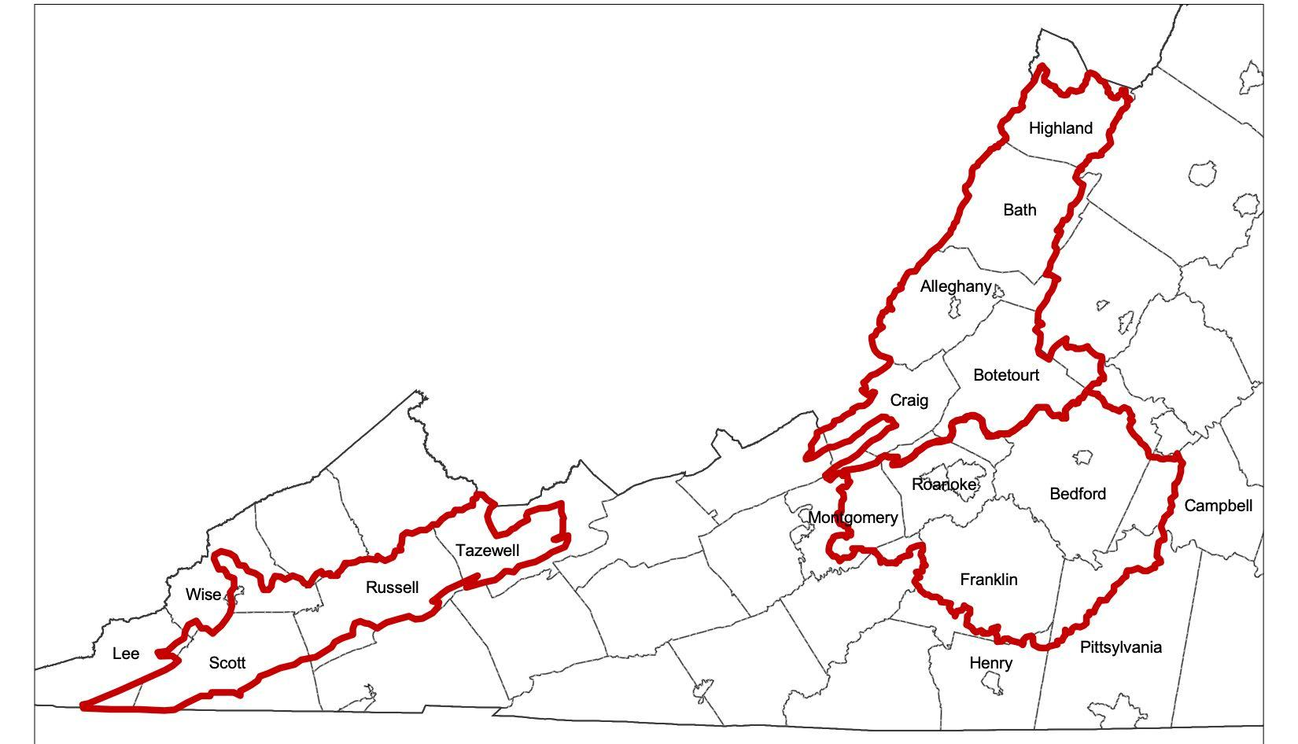
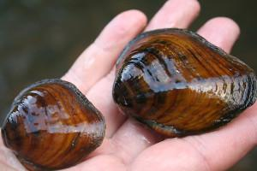
Virginia
Photo credit: US Fish and Wildlife Service
Fish and Wildlife Service targeting 3 main watershed areas: Upper Clinch River, Upper James River, and Upper Roanoke River.
Chosen for the large number of threatened and endangered species that live there
Efforts include livestock exclusion fences, creation of wooded buffer zones, and stabilizing stream banks.
Photo credit: Clinch-Powell Clean Rivers Initiative
Notes:
31 endangered, 8 threatened, 6 candidate, and 140 federal species of concern in these hydrologic units

Slide 13
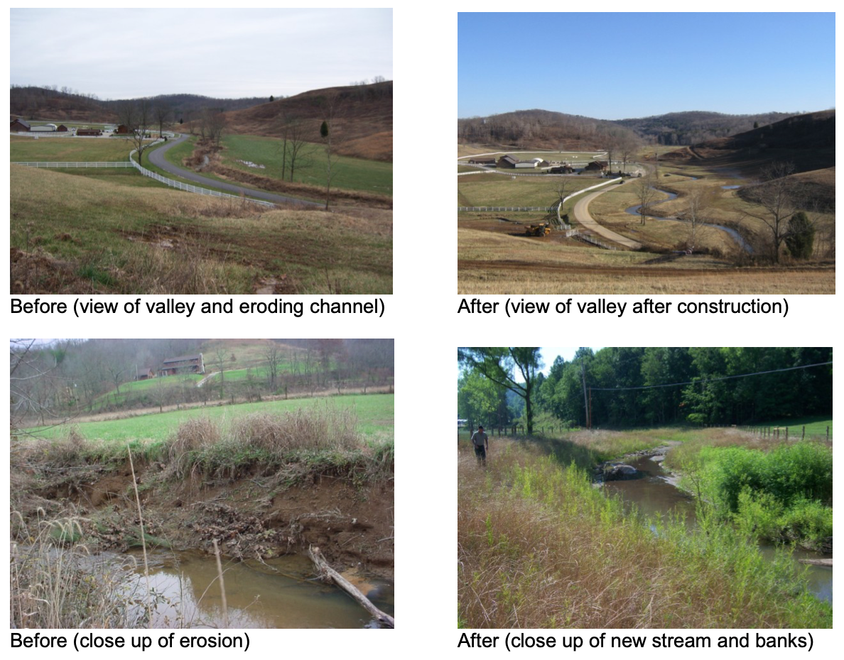
Kentucky
Photo credit: Kentucky Department Fish and Wildlife Conservation Stream Team Program
Kentucky Stream Team program (KY Fish and Wildlife Resources)
Qualifying landowners receive free repairs to eroding and unstable streams
Constructing new stream channels
Installing rock or wood structures to direct flow and reduce erosion
Planting trees

Slide 14
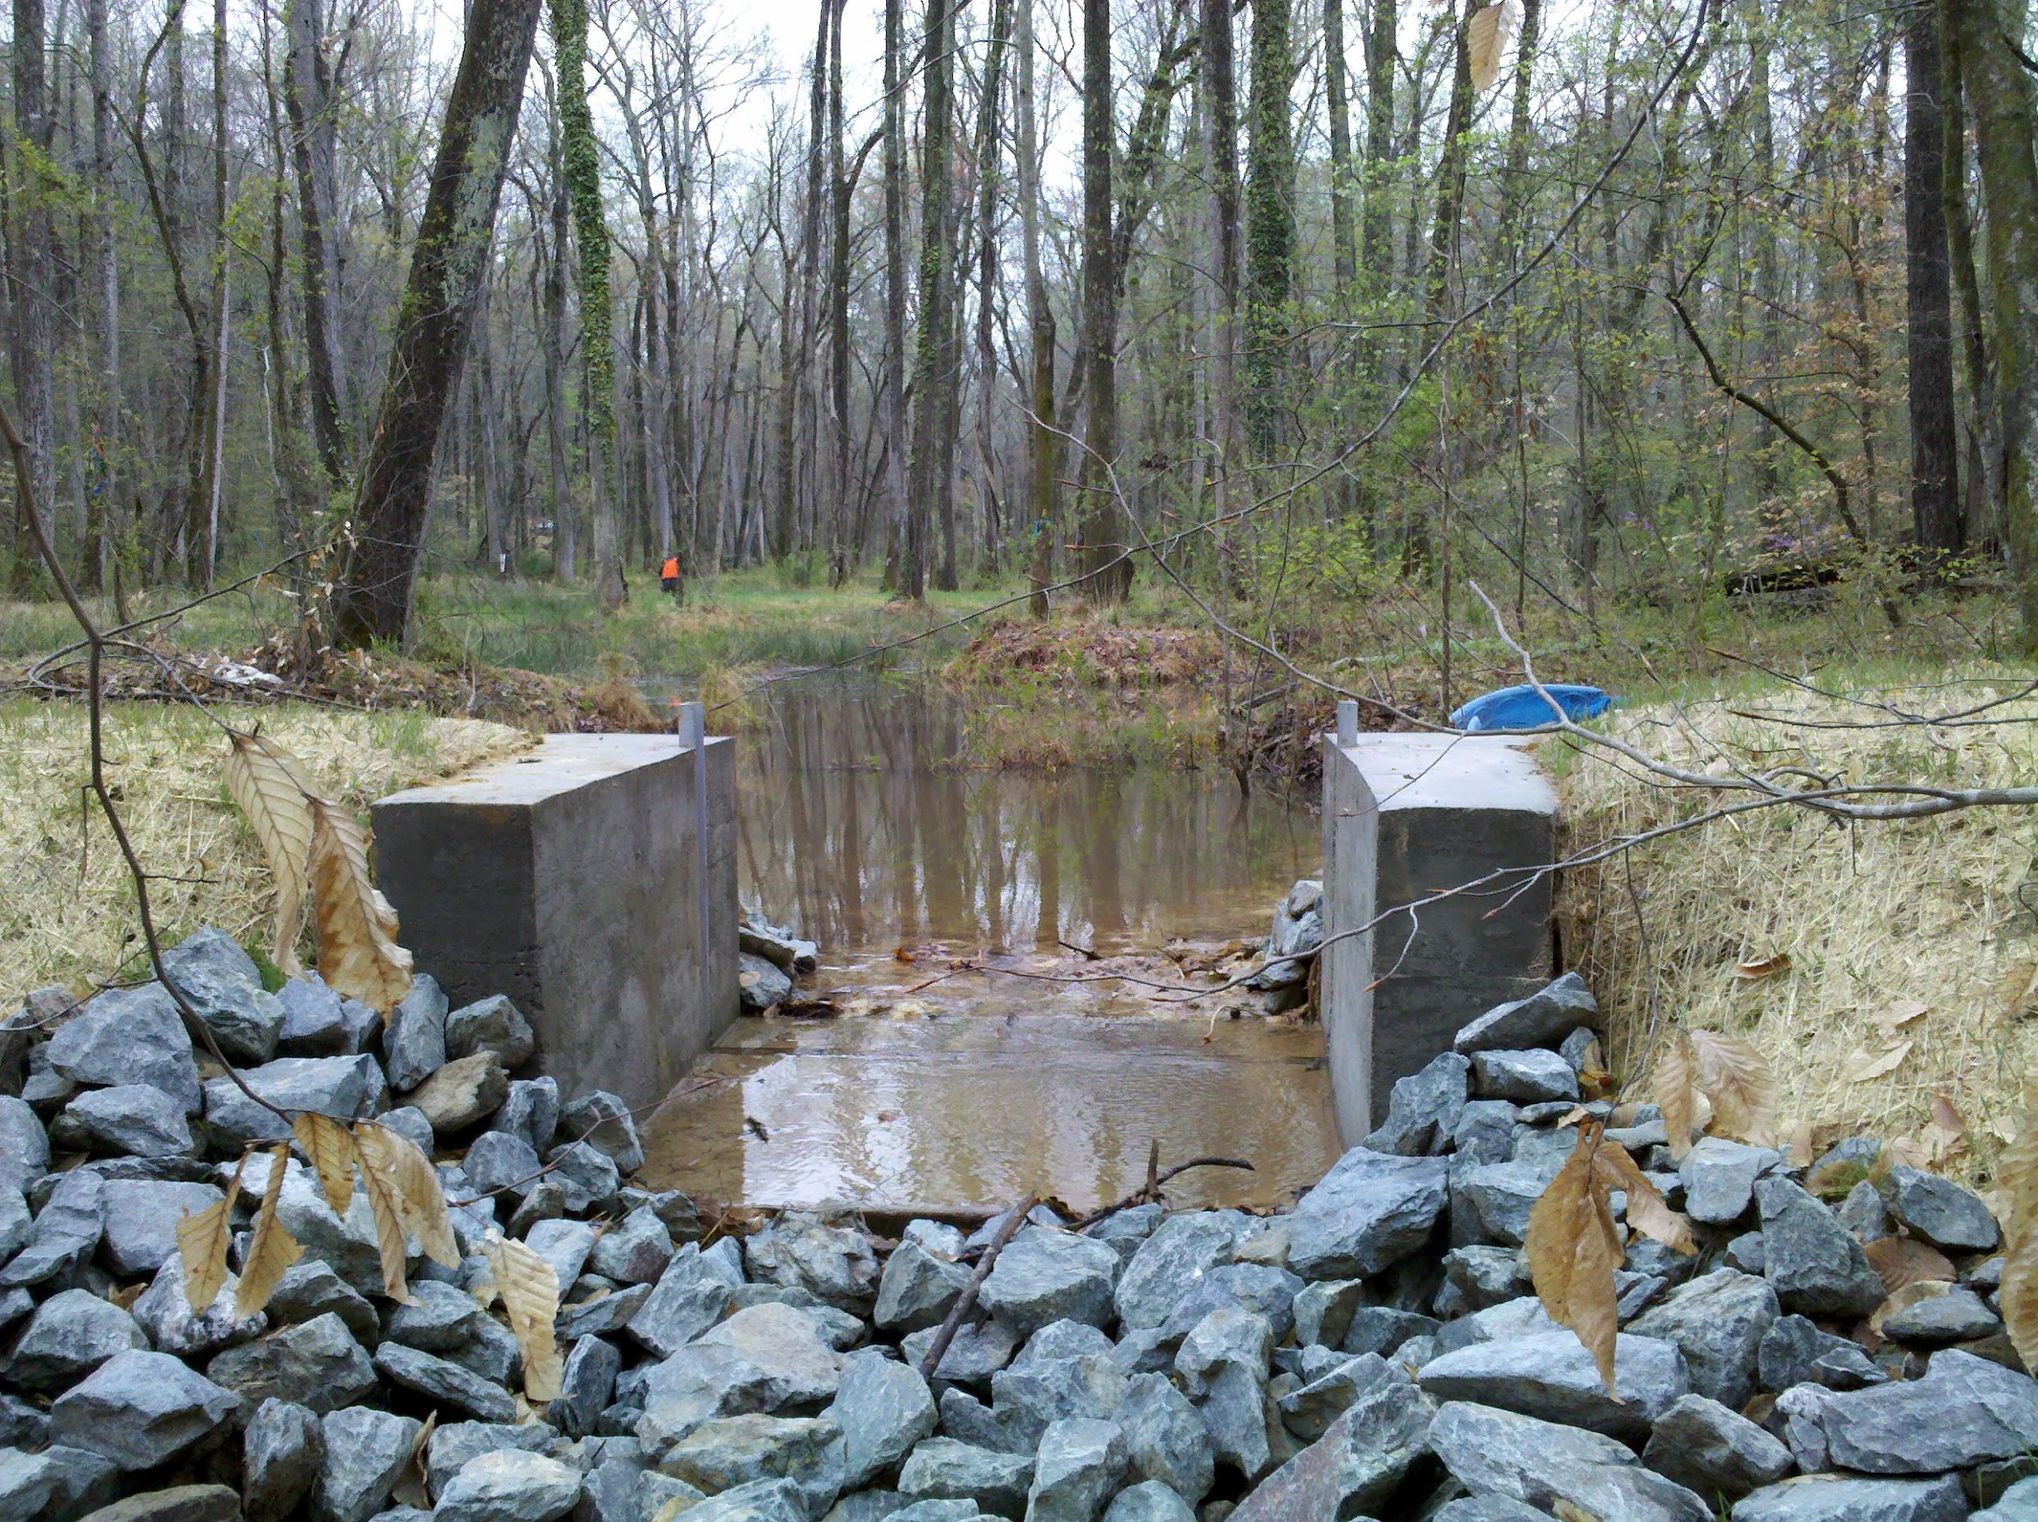
North Carolina
North Carolina Land and Water Fund
Projects focus on:
Restoring degraded streams (preventing bank erosion, repairing and protecting riparian buffer zones)
Stormwater treatment to protect habitats downstream from urban areas
Photo credit: North Carolina Land and Water Fund

Slide 15
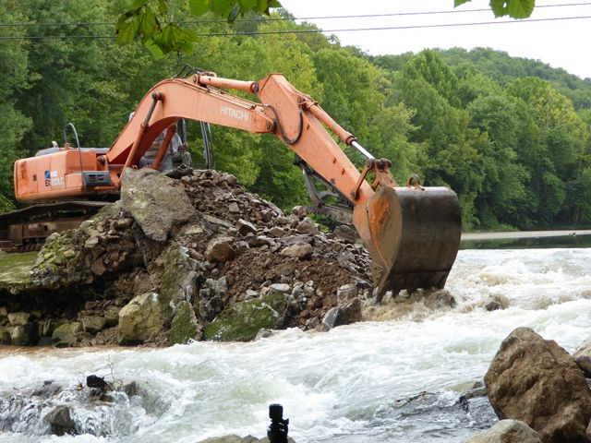
Tennessee
Photo credit: Paul Kingsbury, The Nature Conservancy
The Nature Conservancy’s Tennessee River and Cumberland River program
Focus on:
Removing aquatic barriers like dams
Improving agricultural practices to lessen their impact on streams

Slide 16
On your handout, answer the following question:
What are some common themes across these different states when it comes to stream conservation and restoration? What are some practices that you notice are similar from state to state?
Let’s discuss your answers as a class.

Slide 17
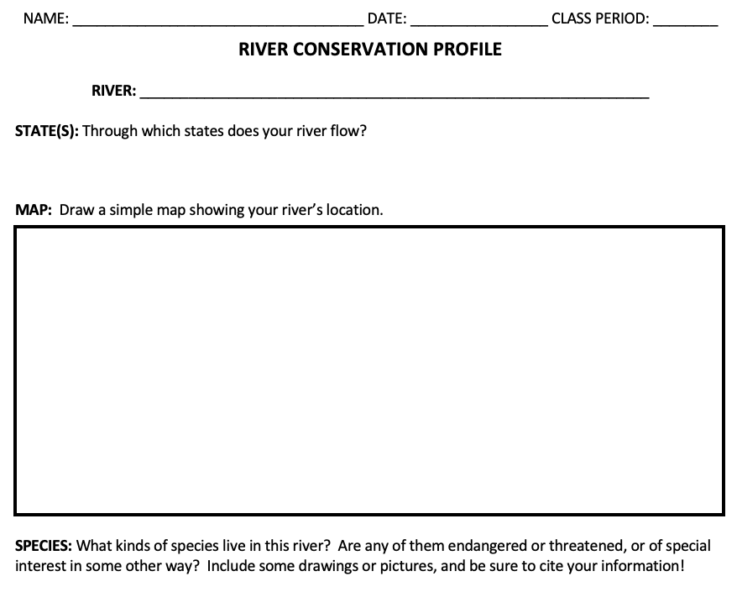
FOCUS: River Conservation Profile
You and a partner are going to work together to construct a River Conservation Profile for a river in Appalachia
As you learn about the river you’ve been assigned and the efforts to protect and conserve it over the years, fill out the handout together

Slide 18
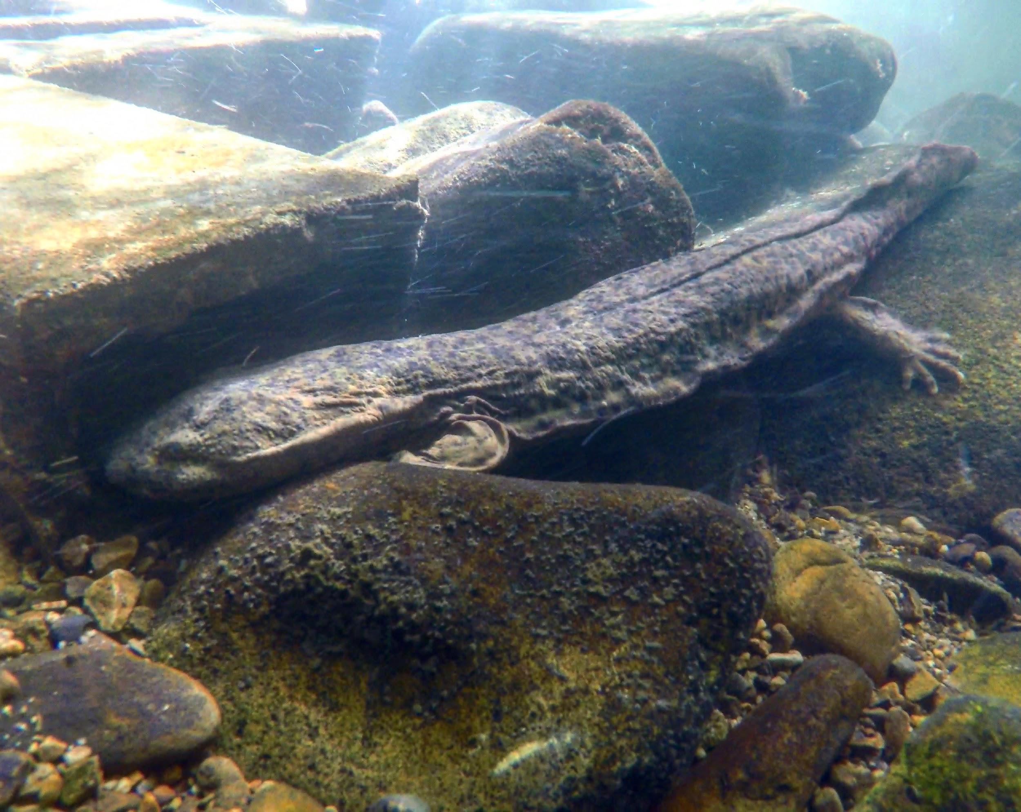
FOCUS: Spread the Word: Share the Hellbender Story!
Take what you’ve learned about the eastern hellbender and construct an educational project that can be used to teach someone else!
Could be a poster, brochure, a PowerPoint presentation, etc. – there are many options.
Your choice should be approved by me before you start your project!
Use the handout (with the rubric on the back) to guide you as you plan, research, and construct your project
Photo credit: Jordy Groffen, Virginia Tech

